Slide 1

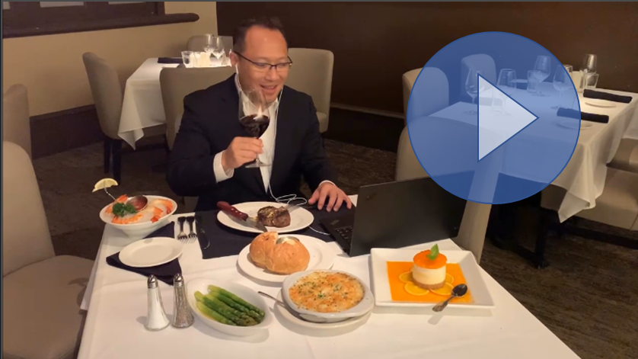
https://www.itleadership.io/Digital-Meet-Up-Digital-MEAT-Up/i-MsDQCm7/A
For Our Sponsors
Leadership “Online” Events (with Multiple Named Accounts)
Targeted “Online” Events (Individual Named Account with their Team Members)

Slide 2


Corona Virus (COVID-19) has created a number of uncertainties for field marketing events and activities because the liability of attendees may be passed on to the Event Sponsor.
As your trusted technology leaders & professionals “Relationship Partner”, our TechExecs “Leadership Events” Network has made an immediate, sizable financial and time investment into creating a solution that we can take to market TODAY!
Introducing:

Slide 3
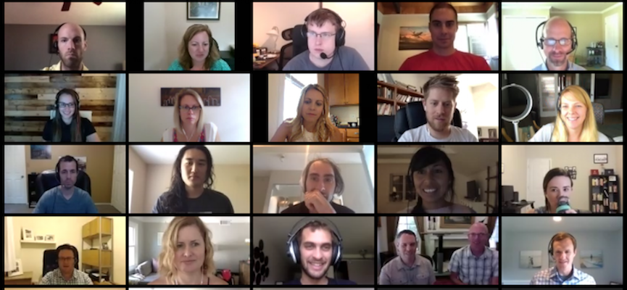
IT, InfoSec or Data Leadership “Online” Events (sponsored by YOU)

Slide 4


Mixed Accounts: It’s Business As Usual
Leadership “Online” Events (with Multiple Named Accounts)
Give Us Your Targeted Named Accounts
We’ll Invite & Recruit “Online Attendees” as usual
We’ll create the eFlyer/Invitation & Registration Form
We’ll leverage Email Campaigns, LinkedIn Connections and Phone Calls
  We’ll even help Boost! Your Account Managers LinkedIn Connections
We’ll schedule a Date, Time and Popular Steakhouse Brand of the City
Registered Attendees will get reminders to the upcoming “Online Event”
When the Online Event starts (All Videos On – based on Zoom Platform)
Some in their Offices, some at Home & some on Mobile & some at Restaurants
  We’ll keep up with the online check-in process
  We’ll do the initial Welcome and Thank You as the Presenting Sponsor
  We’ll go over the Ground Rules & Everyone Introduces Themselves
  You’ll provide the “Industry Update Presentation”
  We’ll facilitate a Roundtable Knowledge Sharing & You are the Facilitator
  You will do a Wrap-Up and while each attendee receives their Digital Dining Certificate (at close of the session)

Slide 5

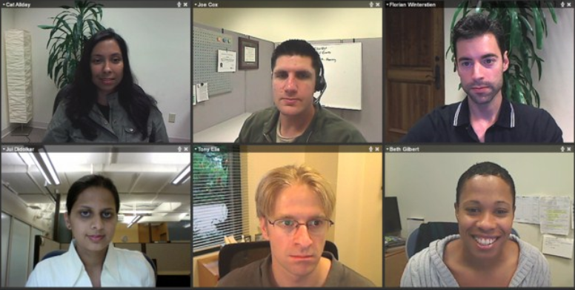
Per Account: It’s Business As Usual
Targeted Team “Online” Events (Individual Named Account with their Team Members)
Give Us Your Targeted Named Accounts
We’ll reach out to CIOs, CISO and create a “Online” Team “Update Event”
We’ll create the eFlyer/Invitation & Calendar Invitation
We’ll leverage Personal Introductions, Email and Phone Calls
We’ll schedule a Date, Time and Popular Steakhouse Brand of the City
Registered Team Members (Attendees) will get reminders to the “Online Session”
When the Online Event starts (All Videos On – based on Zoom Platform)
Some in their Offices, some at the Steakhouse, some at Home & some on Mobile
  We’ll keep up with the online check-in process
  We’ll do the initial Welcome and Thank You as the Presenting Sponsor
  We’ll go around the “room” with quick introductions
  You’ll provide the “Industry Update Presentation”
  You’ll lead the Roundtable Knowledge Sharing & You are the Facilitator
  You will do a Wrap-Up and while each attendee receives their Digital Dining Certificate (at close of the session)

Slide 6



Program Logistic
We’ll do the “Heavy Lifting”
We’ll select the Popular Steakhouse as the “Solo Dining Destination”
  Restaurant is selected based on the City
We’ll secure the Group Dining “Digital Certificate Codes”
  Field Marketing Manager places CC on file for a minimum commitment
  Venue will generate the Digital Redemption Certificate Codes for the # of attendees
  On the day of the event and at the time of the session, the restaurant generate the codes
We’ll setup the Zoom Group Meeting for large audiences using TechExecs Large Format Zoom
  For individual Account Managers’ meetings, we’ll use their Zoom Information.
After the event, we’ll provide the summary (on who attended and who RSVP’ed)
Two Options:
  Leadership “Online” Events (with Multiple Named Accounts) + Partner (may be mixed in-person + Online)
  Targeted Teams “Online” Events (Individual Named Account with their Team Members)

Slide 7










Our High Value & Prestigious Dining Destinations (for Online) Leadership Luncheons
Our Delivery Partners (for workshops)
Electronic Certificates are provided
only to attendees of online events.

Slide 8
Our Technical Platform & Logistics
OPERATIONAL
Field Marketing Managers will provide his/her credit card on file for “Group Events” to the venue
-or- a Purchase Order (PO) can be created and TechExecs will be responsible for working directly
with the restaurant to obtain the Digital Certificates to be redeemed by the attendees.
Field Marketing Managers will engage TechExecs in the same format as before. TechExecs Team
will take care of the administration and behind the scene distribution of the restaurant redemption codes.
For the overall targets for the city, we’ll take on the broad approach of inviting all the name accounts.
For the Targeted Teams/Accounts, we’ll aim to invite “Team Updates” per Account with multiple Team Members.
Electronic Certificates are provided
only to attendees of online events.
TECHNICAL
We will provide our large-format ZOOM meeting platform and will add the into the Calendar Invitation. This platform will allow 100 active videos and 10,000 viewers at the same time. **Note: Our events are for well-qualified IT Leaders and typically will have an approx. 24 ~40 attendees.
TWO FORMATS
FORMAT 1: COMPLETELY VIRTUAL
  These are “Online Events” being broadcasted directly via Zoom Large Format Webinar.
  TechExecs will be the Event Moderator providing Check-In, Welcome, Introduction, Ground Rules & Moderation
  YOU (our sponsor) will be the Industry Update Presenter
  We (TechExecs) will be sending out the “Digital Certificates” during the Wrap Up/Closing of the session.
FORMAT 2: MIXED ENVIRONMENT (with a Partner, for example)
  Current In-Person Events will now be simulcasted via Zoom Large Format Webinar.
  Presenter’s Laptop will be turned “ON” and slide advances will be shown to the attendees at the venue, and at the same time, being broadcasted to the attendees who joined online.
  We (TechExecs) will be sending out the “Digital Certificates” during the Wrap Up/Closing of the session

Slide 9
Contact Information
Paul Curlee, National Director
TechExecs “Leadership Events” Network
paul.curlee@techexecs.net
Text: 832.851.0966 (USA & CANADA) and for EMEA Events, please use email.
IT, InfoSec & Data Leadership “Online Events” (sponsored by YOU)

